Slide 1


Complex Innovative Trial Designs in VA Cooperative Studies Mei-Chiung Shih, Bruce Chow, Ilana Belitskaya-Levy Palo Alto Cooperative Studies Program Coordinating Center The Bay Area Biotech-Pharma Statistics Workshop November 7-8, 2019

Slide 2

Outline
Brief Introduction of CSP
Two Examples of Complex Innovative Trial Designs:
Adaptive multi-arm multi-stage design
Sequential randomized design

Slide 3


VETERANS HEALTH ADMINISTRATION
Office of Research &
Development
Chief Research & Development Officer:
Rachel Ramoni, DMD, ScD
Research Services
Biomedical Lab
Clinical Science
Health Services - QUERI
Rehabilitation
Programs
Cooperative Studies Program
(Director: Grant Huang)
Million Veteran Program
Policy & Operations
Finance
Communications
PRIDE
- Central IRB
Technology Transfer
Non-Profits
Bioinformatics

Slide 4





CSP Role
CSP designs and conducts multi-site cooperative research.
Ideas
Resources
Tools
Policies & procedures

Slide 5

CSP Mission
To advance the health and care of Veterans through cooperative research studies that produce innovative and effective solutions to Veteran and national healthcare problems.

Slide 6
CSP Organization
CSP
Coordinating Centers (5)
Pharmacy Coordinating Center
Network of Dedicated Enrollment Sites (NODES) (9)
Genomics Infrastructure (DNA Bank, Biospecimen Repository, Pharmacogenomics Analysis Laboratory)
Epidemiology Centers (5)

Slide 7
CSP Center Locations
Seattle, WA
Portland, OR
Boston, MA
Minneapolis, MN
West Haven, CT
Salt Lake City, UT
Hines, IL
Perry Point, MD
Palo Alto, CA
Washington, DC
Durham, NC
Long Beach, CA
Little Rock, AR
San Diego, CA
Albuquerque, NM
Dallas, TX
Center
Node
Multi-center
CSP Coordinating Centers are ISO 9001:2015 registered
Houston, TX

Slide 8
Learning Health Care in VA CSP
Comparative Effectiveness Research (CER)
Direct comparison of existing health care interventions to determine the effectiveness, benefits and risks of different treatment options.
Aim to support evidence-based choices of treatments for patients, providers, and health policy makers
CSP unique advantages
Embed in the largest national health care system
Community of ~3000 researchers
>110 VAMCs have Federal Wide Assurances for research
Central IRB
Electronic Health Record since early 1980s
Implementation of findings into VA and national healthcare

Slide 9
Example 1: CSP #2016
National Adaptive Trial for PTSD-related Insomnia (NAP)
Study Chair: John H. Krystal, MD
Study objective: To evaluate the efficacy of trazodone hydrochloride, eszopiclone and gabapentin (as compared to placebo) as an adjunctive therapy in the treatment of insomnia in veterans with military related PTSD
Primary outcome: Change from baseline in Insomnia Severity Index at 12 wks
Secondary outcomes: PTSD symptoms, depression, quality of life, etc
Target sample size 1224, to be recruited in 3 years from 34 sites
Adaptive Multi-arm Multi-stage (MAMS) Design:
Plan to drop “non-promising” arms at the interim analysis
Re-allocate the remaining sample size of the stopped arms to other arms

Slide 10
CSP #2016 (NAP)
Considerations for interim analysis:
Based on primary outcome
Drop arms for futility?
Would there be sufficient evidence to change practice?
Drop arms for efficacy?
Is it ethical to continue randomizing participants to placebo arm?
What about secondary outcomes (e.g., key secondary outcome CAPS-5 total score)?
Binding vs non-binding
Allocate remaining sample size of terminated arms to the remaining arms?
Pros: Increase the power for the remaining active arms; help maintaining interim analysis results
Cons: No saving in sample size; more complicated final analysis

Slide 11
CSP #2016 (NAP)
Planned interim analysis:
One single interim analysis when half of the target randomized participants have completed the 12-week follow-up (i.e., at 50% information time)
An active treatment arm may be terminated for futility if there is sufficient evidence at the time of interim analysis that the effect size of the arm as compared to placebo is less than the clinically meaningful effect size of 0.35 in the primary outcome.
More specifically, for each active treatment, we will perform a one-sided t-test of whether the effect size is less than 0.35 and terminate those active treatment arms which have p-value < 0.025.
The study will be terminated at the interim if all active treatment arms are stopped early.
Otherwise, allocate remaining sample size of terminated arms to the remaining arms.

Slide 12
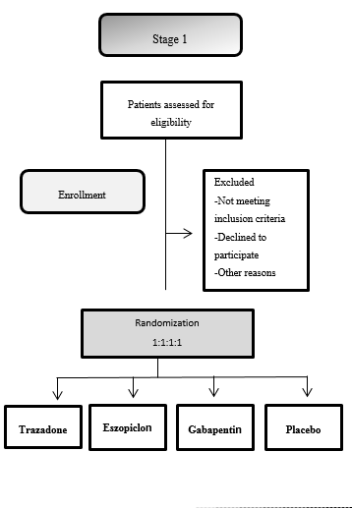
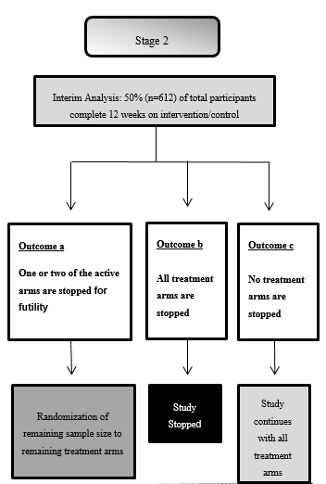
CSP #2016 (NAP)

Slide 13
Sample size considerations
There are three sets of hypotheses for testing the efficacy of individual treatments:
H_{i0}: δ_{i} ≤ 0 versus H_{i1}: δ_{i} > 0, i=1,2,3,
where δ_{i} is the mean difference in the primary outcome between treatment i and placebo, with positive values indicating bigger improvements in the active treatment arm.
An effect size of 0.35 is clinically meaningful
An effect size of 0.2 or smaller is not of clinical interest

Slide 14
Sample size considerations
The sample size of this study is selected to satisfy the following two requirements for power:
When all three active treatments have effect size 0.35, the study has at least 85% probability to establish efficacy of all three active treatments. (Disjunctive power)
When one active treatment (say, treatment 1) has an effect size 0.35 and the other two active treatments have an effect size 0.20, the study has at least 90% probability to recommend treatment 1 as an effective treatment. (Power at the least favorable configuration)

Slide 15
Operating Characteristics
Table 1.1 Probability of Stopping an active arm for futility at the interim analysis
Effect size | Probability that a study arm with the effect size is stopped for futility at the interim analysis using the proposed futility boundary
0.00 | 0.806
0.10 | 0.522
0.20 | 0.226
0.30 | 0.060
0.35 | 0.025
0.40 | 0.009
0.50 | 0.001

Slide 16
Operating Characteristics
Table 1.2 Operating characteristics of the futility boundary
Scenario | Effect size for the three active treatment arms | P( trt 1 is stopped at interim) | P( trt 2 is stopped at interim) | P( trt 3 is stopped at interim) | P(continue 3 active arms to stage 2) | P(continue 2 active arms to stage 2) | P(continue 1 active arm to stage 2) | P(study is stopped at interim)
1 | (0,0,0) | 0.807 | 0.814 | 0.805 | 0.046 | 0.104 | 0.228 | 0.622
2 | (0.35,0.35,0.35) | 0.024 | 0.025 | 0.027 | 0.937 | 0.053 | 0.010 | 0.001
3 | (0.35,0.0,0.0) | 0.025 | 0.801 | 0.803 | 0.084 | 0.228 | 0.664 | 0.025
4 | (0.35,0.1,0.1) | 0.025 | 0.512 | 0.520 | 0.317 | 0.332 | 0.330 | 0.022
5 | (0.35,0.2,0.2) | 0.025 | 0.224 | 0.230 | 0.648 | 0.238 | 0.100 | 0.013
6 | (0.35,0.35,0.0) | 0.023 | 0.025 | 0.812 | 0.188 | 0.768 | 0.039 | 0.004
7 | (0.35,0.35,0.1) | 0.024 | 0.025 | 0.521 | 0.475 | 0.484 | 0.036 | 0.005
8 | (0.35,0.35,0.2) | 0.023 | 0.023 | 0.223 | 0.763 | 0.209 | 0.025 | 0.003
9 | (0.30,0.30,0.1) | 0.060 | 0.058 | 0.527 | 0.460 | 0.450 | 0.076 | 0.014
10 | (0.25,0.25,0.1) | 0.120 | 0.123 | 0.525 | 0.438 | 0.396 | 0.127 | 0.039

Slide 17
Operating Characteristics
Table 1.3 Power of the study
Scenario | Effect size for the three active treatment arms | P(1)* | P(2)* | P(3)* | P(reject any H_{i0} where δ_{i}>0) | P(reject all H_{i0} where δ_{i}>0) | P(reject all H_{i0} where δ_{i}>0.2 and none with δ_{i}≤0) | FWER = P(reject any H_{i0} with δ_{i}≤0) | Expected sample size
1 | (0,0,0) | 0.008 | 0.009 | 0.009 | -- | -- | -- | 0.024 | 721
2 | (0.35,0.35,0.35) | 0.939 | 0.939 | 0.936 | 0.996 | 0.850 | 0.850 | -- | 1039
3 | (0.35,0.0,0.0) | 0.971 | 0.012 | 0.012 | 0.971 | 0.971 | 0.948 | 0.023 | 1027
4 | (0.35,0.1,0.1) | 0.967 | 0.121 | 0.115 | 0.968 | 0.034 | 0.967 | -- | 1029
5 | (0.35,0.2,0.2) | 0.950 | 0.465 | 0.464 | 0.964 | 0.281 | 0.950 | -- | 1033
6 | (0.35,0.35,0.0) | 0.959 | 0.956 | 0.009 | 0.991 | 0.925 | 0.916 | 0.009 | 1037
7 | (0.35,0.35,0.1) | 0.954 | 0.954 | 0.104 | 0.991 | 0.103 | 0.918 | -- | 1037
8 | (0.35,0.35,0.2) | 0.945 | 0.945 | 0.452 | 0.989 | 0.436 | 0.901 | -- | 1037
9 | (0.30,0.30,0.1) | 0.875 | 0.876 | 0.112 | 0.965 | 0.107 | 0.786 | -- | 1033
10 | (0.25,0.25,0.1) | 0.722 | 0.719 | 0.105 | 0.878 | 0.089 | 0.564 | -- | 1018

Slide 18
Example 2: CSP #2009
Sequential and Comparative Evaluation of Pain Treatment Effectiveness Response: The SCEPTER Trial
Study Chairs: David J. Clark, MD, PhD and Matthew J. Bair, MD, MS
Study objective: To identify the optimal approach to chronic low back pain (cLBP) treatment employing commonly recommended non-surgical, non-pharmacological options.
Primary outcome: Change from baseline in pain interference at 3 months
Secondary outcomes/objectives:
Pain severity, depression, anxiety, sleep disturbances, quality of life, etc
Identify predictors of responses to treatments
Evaluate feasibility, barriers and facilitators to implementation
Cost and budget impact analysis
Target sample size 2529, to be recruited in 2.5 years from 20 sites

Slide 19
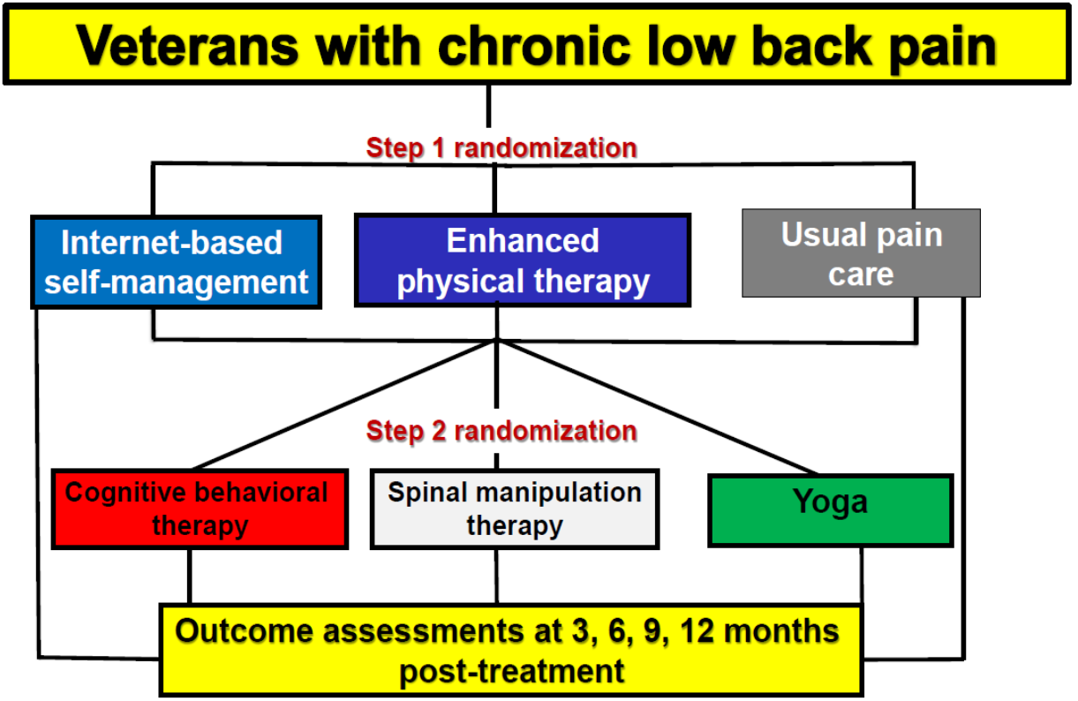
CSP #2009 (SCEPTER)

Slide 20
Primary Objectives
Primary objective 1:
To compare the effectiveness of an internet-based pain self-management program alone, an enhanced physical therapy intervention that combines pain self-management education with tailored exercise guided by a physical therapist, and usual care for the treatment of cLBP.
Primary objective 2:
To compare the effectiveness of cognitive behavioral therapy, spinal manipulation therapy, and yoga in Veterans without a clinically meaningful response to Step 1 treatment (Step 1 non-responders).

Slide 21
Sample size considerations
A mean between-group difference of 1-point in the primary outcome (change of BPI interference score from baseline to 3 months) is considered a clinically meaningful difference
Conservatively assuming a common SD of 2.5, a clinically meaningful difference of 1-point corresponds to a medium effect size of 0.4.
The study sample size is determined by the number of Step 1 non-responders needed in Step 2 to have adequate power to detect all pairwise comparisons among the Step 2 treatments that have a mean group difference of 1-point or greater in the primary outcome.

Slide 22
Sample size considerations
Table 2.1 Number of Step 1 non-responders needed at Step 2 to achieve desired power to detect all pairwise differences between Step 2 treatments
SD | Effect size corresponding to 1-point difference | Mean reduction for the 3 arms | All-pairs power
 |  |  | 80% power | 85% power | 90% power
2.5 | 0.40 | (1, 2, 2) | 153 per arm | 172 per arm | 194 per arm
 |  | (1, 2, 3) | 166 per arm | 180 per arm | 202 per arm
3.0 | 0.33 | (1, 2, 2) | 222 per arm | 245 per arm | 277 per arm
 |  | (1, 2, 3) | 237 per arm | 257 per arm | 288 per arm

Slide 23
Sample size considerations
The final sample size was derived after adjusting for
Correlation due to therapist
Equipoise randomization at Step 2
Anticipated proportion of Step 1 non-responders who are willing to proceed to Step 2
Drop out rate

Slide 24
Sensitivity Analysis for Power
Table 2.2 Sensitivity analysis for the power of primary objective 2
SD | Percent of Step 1 participants with primary outcome who are non-responders and willing to proceed to Step 2
 | 60% (inflation factor 1.72) |  | 50% (Inflation factor 1.57) |  | 40% (inflation factor 1.45)
 | Mean reduction in BPI in the 3 treatment arms
 | (1, 2, 2) | (1, 2, 3) | (1, 2, 2) | (1, 2, 3) | (1, 2, 2) | (1, 2, 3)
2.0 | 99% | 99% | 99% | 98% | 97% | 97%
2.5 | 92% | 90% | 88% | 87% | 82% | 78%
3.0 | 74% | 69% | 70% | 61% | 60% | 49%

Slide 25
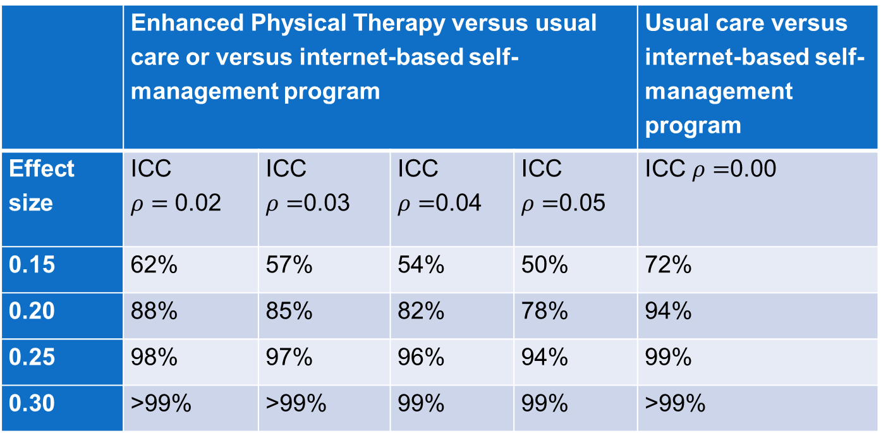
Power for Primary Objective 1
Table 2.3 Power to detect pairwise differences among the Step 1 treatments
 | Enhanced Physical Therapy versus usual care or versus internet-based self-management program |  |  |  | Usual care versus internet-based self-management program
Effect size | ICC $ρ=$ 0.02 | ICC $ρ=$0.03 | ICC $ρ=$0.04 | ICC $ρ=$0.05 | ICC $ρ=$0.00
0.15 | 62% | 57% | 54% | 50% | 72%
0.20 | 88% | 85% | 82% | 78% | 94%
0.25 | 98% | 97% | 96% | 94% | 99%
0.30 | >99% | >99% | 99% | 99% | >99%

Slide 26
CSP #2009 (SCEPTER)
Considerations for interim analysis:
Drop Step 1 treatment arms?
Drop Step 2 treatment arms?
Drop treatment strategies?
It was decided that the study does not plan to stop treatment arms early for efficacy for futility.

Slide 27
CSP #2009 (SCEPTER)
Rationale for not stopping treatment arms early for efficacy or for futility
Step 1:
There are no ethical concerns;
It is important to examine durability of treatment effect in Step 1 responders and comparative effectiveness of subsequent Step 2 treatments in Step 1 non-responders even when there is no difference between Step 1 treatments at 3 months;
It allows us to examine potential interactions between Step 1 and Step 2 treatments.

Slide 28
CSP #2009 (SCEPTER)
Rationale for not stopping treatment arms early for efficacy for futility
Step 2:
There are no ethical concerns
Even when there are differences between these treatments, the differences based on interim analysis results are not likely to alter VA policy to make all evidence-based treatments available to Veterans with cLBP.
Need to collect sufficient data on the secondary outcomes to support findings in the primary outcome.
It allows us to examine the impact of patient preferences, treatment expectations, and patient characteristics on treatment effectiveness.
It allows us to explore adaptive treatment strategies of cLBP.

Slide 29
Concluding Remarks
Complex innovative trial designs can be useful in pragmatic comparative effectiveness setting
Other examples include outcome adaptive randomization and contextual multi-arm bandit design
Thanks to CSP #2009 and #2016 study teams and study planning committees

